Slide 1
ACI Migration Infrastucture
GTS/HCS
04/07/2018

Slide 2
Foreseen architecture
In addition to ACI, 2 OTV L2DCI networks will be built :
Production flows migration OTV
Replication flows migration OTV
PS: Seclin 2 ACI and OTV infrastructure will be rolled-out in a second step (2019)

Slide 3
Production Flows migration OTV
It’s a dedicated “per fabric” OTV network carried over the MAN infrastructure.
As the MAN is the underlay infrastructure a poor capacity (<< 10G) is available on legacy sites (Tigery and Clichy)

Slide 4
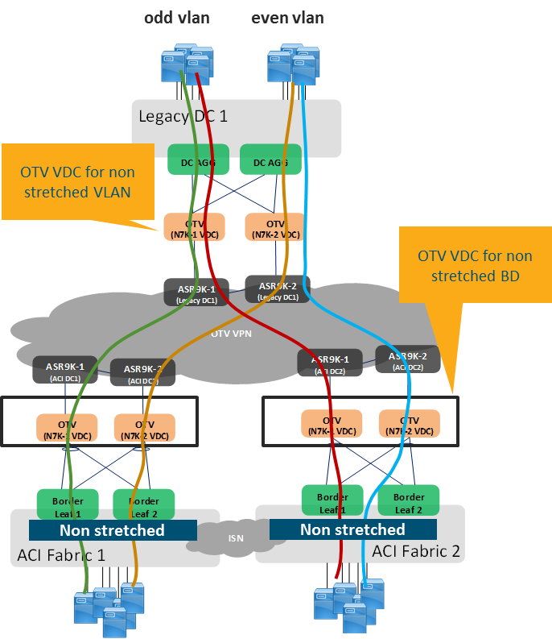
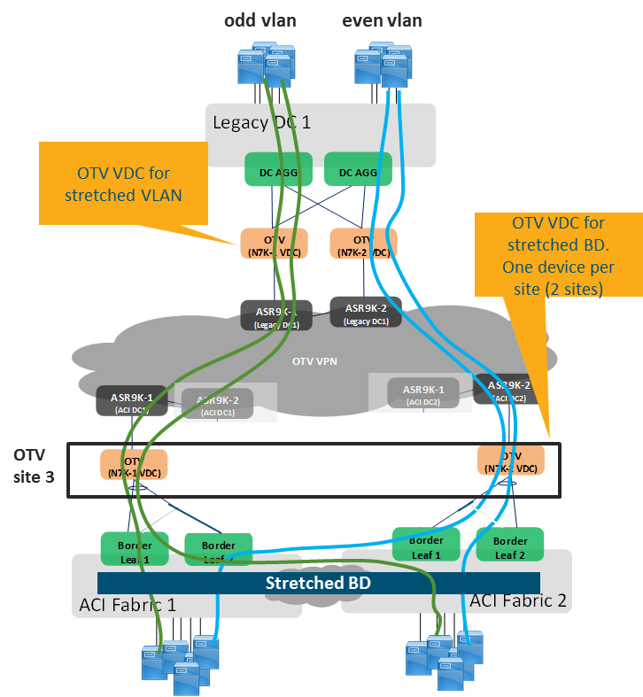
2 logical OTV per fabric
Two logical OTV network will be built for each multisite fabric :
OTV for local BDs
OTV for stretched BDs

Slide 5
Production Flows migration OTV – VDC
Two VDC will be configured :
PS: these N7K nodes will also be used for fabric routing workarounds.

Slide 6
Replication Flows migration OTV – VDC
A huge traffic is expected for data replication (distributed file systems, data storage, VMotion). A dedicated OTV network will be built for this purpose :

Slide 7
2 logical OTV per fabric
Two logical OTV network will be built for each multisite fabric :
OTV for local BDs
OTV for stretched BDs

Slide 8
Replication Flows migration OTV – VDC
We will have :
2 OTV VDC per fabric (up to 4 fabric per sites)
1 routing VDC
New Sites
Each N7706 will be fit with
3xN77-F312CK-26
26 QFSP 100G multimode
1 or 2 QSFP 100G singlemode

Slide 9
Replication Flows migration OTV – VDC
Legacy Sites
Each N7706 will be fit with
2xN77-F312CK-26 (12x100G linecard)
1xN77-F324FQ-25 (24x40G linecard)
14 QFSP 100G bidi (if avail)
1 QSFP 100G singlemode
NxQSFP 40G (2 ports per infra to be collected)

Slide 10
Replication Flows migration OTV – Physical Network
A single routing plan network will be build using N7706 devices.
A ring 100G topology will allow to get a full resiliency.
Seclin 2 will be rolled-out in a second step (2019)
Proposed OTV physical topology:

Slide 11
Replication Flows migration OTV – Physical Network
On some sites - where we will have both ACI and legacy infrastructure – 4 nodes will be deployed :
2 nodes to interconnect ACI fabric (N7K-01/N7K-02)
2 nodes to interconnect all legacy blocks to be migrated (N7K-03/N7K-04).

Slide 12
A real use case – Cloud infrastructure migration

Slide 13
Foreseen architecture
In order to be provide L2 connectivity between the new DC LAN Block (ACI) with the legacy ones we have to interconnect them on our new OTV infrastructures :

Slide 14
How it works
Production flows OTV is used for Ethernet connectivity between VM migrated onto the new DC and those that are remaining on the legacy ones (that are in a same IP subnet).
Replication flows OTV is used to migrate DATA from the legacy site to the new one (several TB to migrate)

Slide 15
Capacity issue
We only have 10G uplink connectivity to OTV on the legacy site.
OTV is built over MAN connectivity and less than 10G is currently available.
Issue !!!

Slide 16
CFD upgrade could be required
No 40G interface is available on current CFD
Only 10G interfaces are available.

Slide 17
POD Migration specific interconnection on OTV for replication flows
Each POD top of rack switch is specifically interconnected onto a new migration infrastructure in order to avoid the overload created by replication flows.

Slide 18
POD Connectivity overview

Slide 19
CLOUD MIGRATION STRATEGY

Slide 20
Migration steps
STEP ONE : NEW POD CREATION
All PODs are interconnected with 2x40G links with an 100G L2 migration OTV for replication network.

Slide 21
Migration steps
STEP TWO : DATA MIGRATION
We are using specific OTV for replication connectivity to move the DATA from the legacy POD to the new one.
East/West traffic inside the Cloud AZ is carried over OTV for production flows

Slide 22
Migration steps
STEP THREE : ROUTING UPDATE
Cloud External routing point is migrated from legacy sites to new ones. Production L2DCI will be used for “east west” communications.

